Slide 1


Slide 2
Chapter 22
Object-Relational and
Extended-Relational Systems

Slide 3
Chapter Outline
22.1 Overview of Object-Relational Features of SQL
22.2 Evolution and Current Trends
22.3 The Informix Server
22.4 Object-Relational Features of Oracle
22.5 Implementation and Related Issues for Extended Type Systems
22.6 The Nested Relational Model
22.7 Summary

Slide 4
Chapter Objectives
To address the following questions:
  What are the shortcoming of the current DBMSs?
  What has led to these shortcomings?
Identify new challenges
  How Informix Universal Server and Oracle have addressed some of the challenges

Slide 5
Section 22.1
SQL’s Object-Relational Features
SQL was specified in 1970s
SQL was enhanced substantially in 1989 and 1992
A new standard called SQL3 added object-oriented features
A subset of SQL3 standard, now known as SQL-99 has been approved

Slide 6
Component of the SQL Standard
SQL/Framework, SQL/Foundation, SQL/Bindings, SQL/Object
New parts addressing temporal, transaction aspects of SQL
SQL/CLI (Call Level Interface)
SQL/PSM (Persistent Stored Modules)

Slide 7
SQL/Foundation
New types
New predicates
Relational operators
Rules and triggers
User defined types
Transaction capabilities
Stored routines

Slide 8
SQL/CLI
SQL/CLI stands for SQL Call Level Interface
SQL/CLI provides rules that allow execution of application code without providing source code
  Avoids the need for preprocessing
  Contains about 50 routines for tasks such as connection to the SQL server

Slide 9
SQL/PSM
PSM = Persistent Stored Modules
  Specifies facilities for partitioning an application between a client and a server
  Enhances performance by minimizing network traffic
  SQL Bindings included Embedded SQL
  SQL/Temporal deals with historical data

Slide 10
Object-Relational Support in
SQL-99
Type constructors to specify complex objects
Mechanism to specify object-identity
Mechanism for encapsulation of operations
Mechanism to support inheritance
  I.e., specify specialization and generalization

Slide 11
Type Constructors (1)
Two types: row and array
Known as user-defined types (UDTs)
Syntax for a row type
  CREATE TYPE row_type_name AS [ROW] (<component decln>)
An example:
CREATE TYPE Addr_type AS (
street VARCHAR (45),
city VARCHAR (25),
zip CHAR (5));

Slide 12
Type Constructors (2)
An array type is specified for an attribute whose value will be a collection
Example:
  CREATE TYPE Comp_type AS (
  comp_name VARCHAR (2).
  location VARCHAR (20) ARRAY [10]
  );
Dot notation is used to refer to components
  E.g., comp1.comp_name is the comp_name part of comp1 (of type Comp_type)

Slide 13
Object-Identifiers Using References
A user-defined type can also be used to specify the row types of a table:
CREATE TABLE Company OF Comp_type
(REF IS comp_id SYSTEM GENERATED,
PRIMARY KEY (comp_name));
Syntax to specify object identifiers:
REF IS <oid_attribute> <value_generation_method>
Options:
  SYSTEM GENERATED
  or DERIVED

Slide 14
Attributes as References
A component attribute of one tuple may be a reference:
  CREATE TYPE Employment_type AS (
  employee REF (Emp_type) SCOPE (Employee),
  company REF (Comp_type) SCOPE (Company));
Keyword SCOPE specifies the table whose tuples can be referenced by a reference attribute via the dereferencing notation ->
  E.g., e.company->comp_name

Slide 15
Encapsulation of Operations
A construct similar to the class definition
Users can create a named user-defined type with its own methods in addition to attributes:
CREATE TYPE <type-name> (
list of attributes
declaration of EQUAL and LESS THAN methods
declaration of other methods
);

Slide 16
Method Syntax
Syntax:
  METHOD <name> (<arg-list>) RETURNS <type>;
An example
CREATE TYPE Addr_type AS (
street VARCHAR (45),
city VARCHAR (25),
zip CHAR (5)
)
METHOD apt_no ( ) RETURNS CHAR(8);

Slide 17
Inheritance in SQL
Inheritance is specified via the UNDER keyword
Example
CREATE TYPE Manager_type UNDER Emp_type AS (dept_managed CHAR (20));
Manager_type inherits all features of Emp_type
  and it has an additional attribute called dept_managed

Slide 18
Other Operations and New Features
WITH RECURSIVE is used to specify recursive queries
User accounts may have a role that specifies the level of authorization and privileges;
  Roles can change
Trigger granularity allows row-level and statement-level triggers
SQL3 also supports programming languages facilities

Slide 19
Section 22.2
Evolution of Database Technology
Several families of DBMS products
Two important ones:
  RDBMS
  ODBMS
Two major legacy DBMSs:
  Network
  Hierarchical
Interoperability concerns:
  While legacy systems are replaced by new offerings, we may encounter various issues

Slide 20
Current Trends
Main force behind development of ORDBMSs: meet the challenges of new applications:
  Text
  Images
  Audio
  Streamed data
  BLOBs (binary large objects)

Slide 21
Section 22.3
The Informix Universal Server
Combines relational and object database technologies
Consider two dimensions of DBMS applications:
  Complexity of data (x)
  Complexity of queries (y)
Observe the possible quadrants

Slide 22
Four Quadrants of DBMS Applications
Observe the possible quadrants
  Quadrant 1 (x=0, y=0): simple data, simple query
  Quadrant 2 (x=0, y=1): simple data, complex query
  Quadrant 3 (x=1, y=0): complex data, simple query
  Quadrant 4 (x=1, y=1): complex data, complex query
Traditional RDBMSs belong to Quadrant 2
Many object DBMSs belong to Quadrant 3
Informix Universal belongs to Quadrant 4
  It extends the basic relational model by incorporating a variety of features that make it object-relational

Slide 23
How Informix Universal Server Extends the Relational Data Model
Support for extensible data types
Support for user-defined routines
Implicit notion of inheritance
Support for indexing extensions
Database Blade API

Slide 24
Informix Universal Server’s Extensible Data Types
DBMS is treated as razor into which data blade modules can be inserted
A number of new data types are provided
  Two-dimensional geometric objects
  Images
  Time series
  Text
  Web pages

Slide 25
Informix Universal Server’s Constructs to Declare Additional Types
Opaque type:
  Encapsulates a type (hidden representation)
Distinct type:
  Extends an existing type thru inheritance
Row type:
  Represents a composite type (like C’s struct)
Collection type:
  Lists, sets, multi-sets (bags)

Slide 26
Informix Universal Server’s Support for User-Defined Routines
Informix supports user-defined functions and routines to manipulate user-defined types
Functions are implemented
  Either in Stored Procedure (SPL)
  Or in a high-level programming language (such as C or Java)
Functions can define operations like
  plus, times, divide, sum, avg, negate

Slide 27
Informix Universal Server’s Support for Inheritance
Informix supports inheritance at two levels:
  Data
  Operation
Data inheritance is used to create sub-types (thru the RETURN keyword):
CREATE ROW TYPE employee_type (…);
CREATE ROW TYPE engineer_type ( …)
UNDER employee_type;
CREATE ROW TYPE engineer_mgr_type ( …) UNDER engineer_type;

Slide 28
Informix Universal Server’s Support for Indexing
Informix supports indexing on user-defined routines in a single table or a table hierarchy:
CREATE INDEX empl_city
ON employee (city (address));
The above line creates an index on the table employee using the value of the city function

Slide 29
Informix Universal Server’s Support for External Data Source
Informix supports external data sources
  E.g., data stored in a file system
External data are mapped to a table in the database called virtual table interface
The interface enables the user to defined operations that can be used as proxies

Slide 30
Informix Support for Data Blade Application Programming Interface
Two dimensional (spatial) data types
  E.g., a point, line, polygon, etc.
Image data types:
  tiff, gif, jpeg, FAX
Time series data type
Text data type:
  a single data type called doc whose instances are large objects

Slide 31
Section 22.4
Object-Relational Features of Oracle
VARRAY for representing multi-valued attributes
CREATE TYPE phone_type
AS OBJECT (phone_number CHAR (10));
CREATE TYPE phone_list_type
AS VARRAY (5) of phone_type;
CREATE TYPE customer_type AS
OBJECT (customer_name(VARCHAR (20), phone_numbers phone_list_type);
CREATE TABLE customer of customer_type;
SELECT customer_name phone_numbers FROM customer;

Slide 32
Managing Large Objects
Oracle can store extremely large objects:
  RBLOB (binary large object)
  CLOB (character large object)
  BFILE (binary file stored outside the database)
  NCLOB (fixed-width multibyte CLOB)

Slide 33
Section 22.5:
Implementation and Related Issues
The ORDBMS must dynamically link a user-defined function in its address space
Client-server issues:
  if a server needs to perform a function, it is best to do so in the DBMS (server) address space
Queries should be possible to run inside functions
Efficient storage and access of data
  Especially given new types, is very important

Slide 34
Other Issues
Object-relational database design
  Object-relational design is more complicated
Query processing and optimization
Interaction of rules with transactions

Slide 35
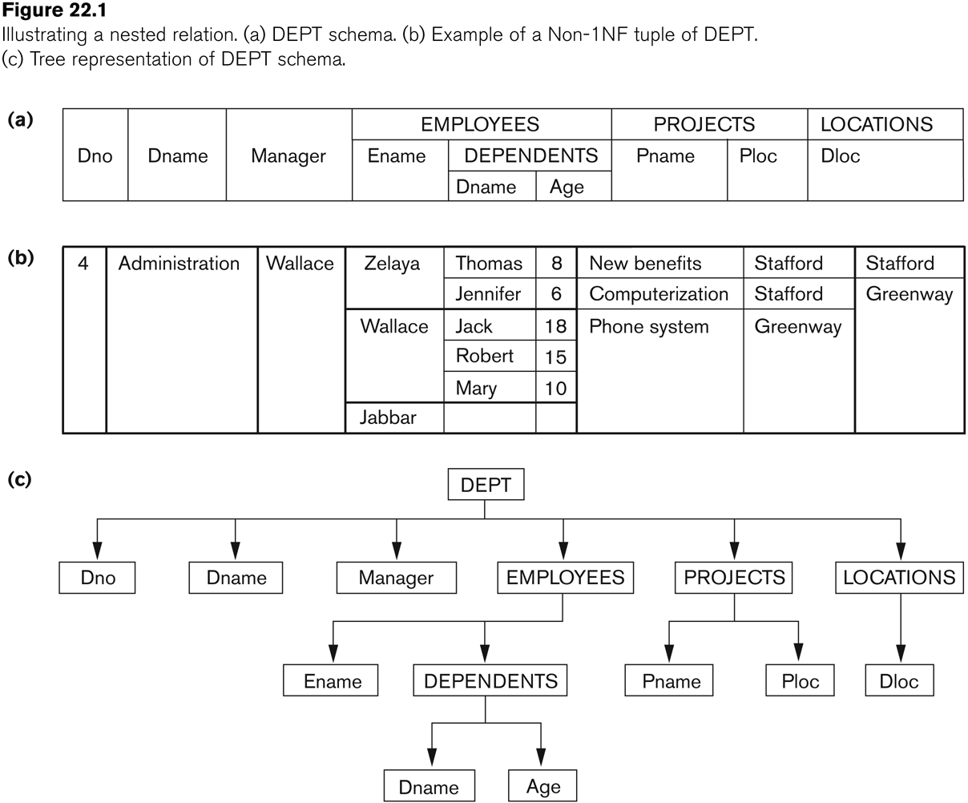
Section 22.6
Nested Relational Model
Nested relational mode:
  Removes the restriction of the first normal form (1NF)
No commercial
database supports a
nested relational model
Visual representation:
DEPENDENT

Slide 36
Attributes of Nested Relations
Simple value attributes
Multi-valued simple attributes
Multi-valued composite attributes
Single-valued composite attributes

Slide 37
Manipulating Nested Relations
Extension made to
  Relational algebra
  Relational calculus
  SQL
Two operations for converting between nested and flat relations:
  NEST
  UNNEST

Slide 38
Example of NEST
To nest un-nested attributes:
  EMP_PROJ_FLAT ←
  П SSN, ENAME, PNUMBER, HOURS (EMP_PRO)
  EMP_PROJ_NESTED ←
  NEST PROJ = (PNUMBER,HOURS) (EMP_PROJ_FLAT)
Nested relation PROJS within EMP_PROJ_NESTED groups together the tuples with the same value for the attributes that are not specified in the NEST operation

Slide 39
Example of UNNEST
UNNEST operation is the inverse of NEST; thus we can recover EMP_PROJ_FLAT:
EMP_PROJ_FLAT ← UNNEST PROJS = (PNUMBER,HOURS) (EMP_PROJ_NESTED)

Slide 40
Summary
An overview of the object-oriented features in SQL-99
Current trends in DBMS that led to the development of object-relational models
Features of Informix Universal Server and Oracle
Nested relational models

